Slide 1

CCA 2020 Annual Report
May 2021
Gabe Davis
Executive Director

Slide 2


2

Slide 3
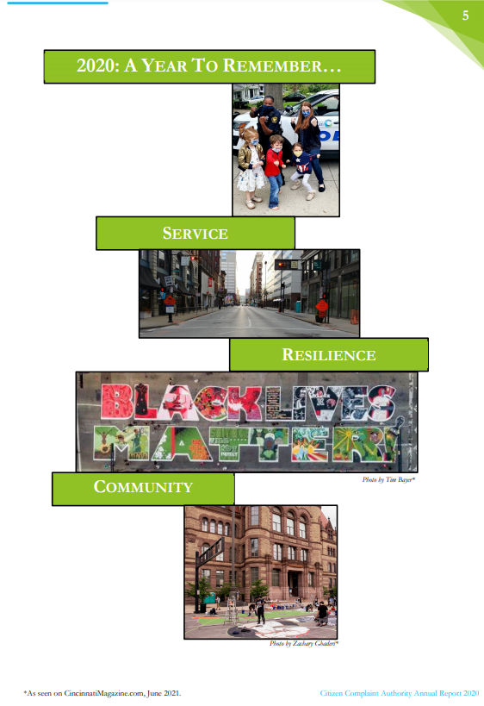
3

Slide 4
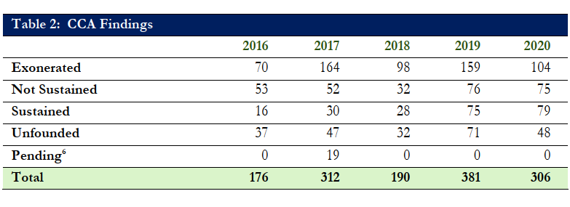
4

Slide 5
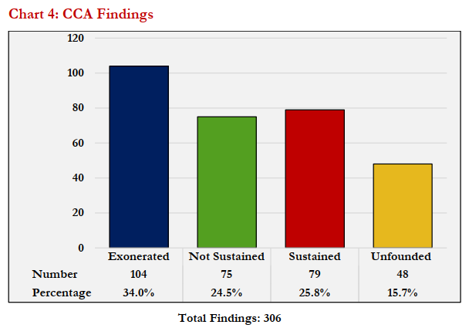
5

Slide 6

6
Five-Year CCA Finding Trend

Slide 7
7
Assigned Citizen Complaints
CCA Case Totals |  | IIS/CCRP Case Totals
2020 75 |  | 2020 174
2019 84 |  | 2019 200
2018 77 |  | 2018 164
2017 65 |  | 2017 177
2016 85 |  | 2016 168
Notes:
Total of 249 complaints reviewed by CCA in 2020.
Withdrawn complaints are in addition to CCA or IIS/CCRP totals.
IIS/CCRP Case Totals for previous years include CCA NJ
Withdrawn:
2019 – 285 including 1 Withdrawn
2018 – 243 including 2 Withdrawn
2017 – 244 including 2 Withdrawn
2016 – 253 including 0 Withdrawn
2015 – 286 including 16 Withdrawn

Slide 8
8
Five-Year Complaint Trend

Slide 9
9
Five-Year CCA Complaint and Allegation Trend

Slide 10
10
Five-Year Allegations
Allegations | 2016 | 2017 | 2018 | 2019 | 2020
Criminal | 0 | 0 | 1 | 0 | 0
Death (TASER) | 1 | 0 | 0 | 0 | 0
Death in Custody | 0 | 10 | 7 | 0 | 1
Detention | 4 | 1 | 2 | 7 | 6
Discharge of Firearm | 9 | 3 | 12 | 3 | 4
Discourtesy | 33 | 18 | 9 | 39 | 35
Discrimination | 16 | 8 | 16 | 15 | 26
Frisk | 0 | 0 | 0 | 0 | 0
Harassment | 8 | 7 | 9 | 18 | 13
Lack of Service | 1 | 10 | 13 | 16 | 9
Law Violation | 0 | 0 | 0 | 0 | 1
Pointing of a Firearm | 17 | 12 | 9 | 10 | 19
Procedure | 27 | 15 | 6 | 28 | 19
Racial Profiling | 0 | 4 | 0 | 6 | 0
Search/Seizure/Entry | 86 | 49 | 45 | 42 | 79
Sexual Misconduct | 2 | 0 | 0 | 2 | 0
Stop | 26 | 26 | 26 | 44 | 33
Unethical Conduct/Misconduct | 0 | 0 | 0 | 9 | 1
Use of Force/Excessive Force | 73 | 56 | 54 | 83 | 65
Total | 301 | 219 | 209 | 322 | 311
Notes:
Top 5 Allegations assigned to complaints investigated by CCA in 2020
Use of Force /Excessive Force
Search/Seizure/Entry
Discourtesy
Stop
5) Discrimination

Slide 11
11
Complainant Demographics

Slide 12
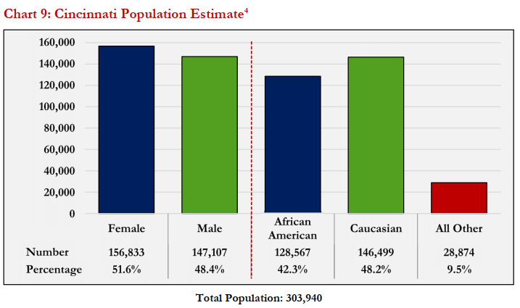
12

Slide 13
13
Officer Demographics

Slide 14
14
Officer Demographics

Slide 15
15
2020 Accomplishments
CCA commenced 75 new investigations based on citizen complaints. In addition, CCA referred 174 complaints to the Cincinnati Police Department (CPD) for investigation after screening and reviewing those complaints.
CCA completed 44 investigations in and issued 306 findings associated with those cases.
CCA responded to the scene of all officer-involved shootings (3 total).
CCA responded to the scene of all cases involving deaths in police custody, or deaths potentially resulting from police action (2 total).

Slide 16
16
2020 Accomplishments
CCA collaborated with CPD on CPD’s periodic review of its use of force procedures, during which CCA issued multiple recommendations regarding CPD’s proposed policy revisions.
CCA issued over 15 unique recommendations to the CPD. Those recommendations addressed police policy and training, including the following topics: investigatory stops, searches and frisks, Body Worn Camera (BWC) evidentiary access, BWC use policy, CPD’s Use of Force Review Board, TASER deployment, defining harassment as an allegation, and more.
Notes:
Patterns Report examined a 3-year period and tracked
(i) officers who have received a high number of complaints,
(ii) repeat complainants, and
(iii) the top circumstances that formed the bases for complaints.

Slide 17
17
2020 Accomplishments
CCA participated and led 19 community engagements and trainings, reaching approximately 270 people.
CCA provided public with opportunity to participate in CCA’s monthly Board Meetings virtually, for the first time in CCA’s history.
CCA published its 2019 Annual Report, which summarized CCA’s activities and outcomes for the 2019 calendar year.
CCA published its 2019 Patterns Report.
Notes:
Board Meeting revamp:
Increased opportunities for community to…
(i) offer comments and questions during monthly Board Meetings;
(ii) provide qualitative feedback to CCA’s on its efficacy; and
(iii) become educated about issues related to community concerns through the use of guest speakers

Slide 18
18
2020 Accomplishments
CCA liaised with and provided guidance to public officials and representatives from other cities interested in creating an oversight agency or improving existing oversight functions.
CCA hired, onboarded, and trained 3 new experienced and diverse Investigators, including a former NYPD detective fluent in Spanish, a former Cleveland prosecutor, and a counterintelligence investigator from the U.S. Intelligence Community.

Slide 19



Where Can You Find It?
19
Website: https://www.cincinnati-oh.gov/ccia/citizen-complaint-annual-reports/2020-annual-report/

